Slide 1

Entity Framework
Notes:
Hi all.Welcome to aitrich Accademy.Today we are discussing about the topic Entity Framework. Framework (EF) is an object-relational mapping (ORM) framework for .NET developers. It simplifies the process of interacting with databases by allowing you to work with data as objects in your code, abstracting away the complexities of database management.Here we are discussing about the topic ORM,Entities, DbContext, Code-First Approach, Migration and so on.

Slide 2


ORM(Object Relational Mapping)
Object Relational Mapping (ORM) is a technique used in creating a "bridge" between object-oriented programs and, in most cases, relational databases.
While using SQL for this purpose isn't necessarily a bad idea, the ORM and ORM tools help simplify the interaction between relational databases and different OOP languages.
Notes:
ORM(Object Relational Mapping)
starting with a discussion about Object-Relational Mapping (ORM) before diving into Entity Framework is a great approach to ensure everyone has a solid understanding of the foundational concepts. Let's start by exploring ORM in more detail. ORM is a programming technique used to bridge the gap between the object-oriented paradigm of programming languages and the relational model of databases. In traditional software development, data is stored in relational databases, while object-oriented programming languages represent data as objects with attributes and methods. ORM simplifies the interaction between these two worlds by providing a way to map database records to objects in code and vice versa.Key Concepts of ORM is Entities, Attributes, Relationships.Here Entities represents Objects representing data stored in the database, typically corresponding to tables, Attributes represents Properties of entities that map to columns in the database table, Relationships represents Associations between entities, such as one-to-one, one-to-many, or many-to-many relationships. While using SQL directly for database interactions is effective and widely used, Object-Relational Mapping (ORM) and ORM tools offer several advantages that simplify the interaction between relational databases and object-oriented programming (OOP) languages like Java, C#, or Python.

Slide 3

What is an ORM Tool?
An ORM tool is software designed to help OOP developers interact with relational databases.
Here's an example of SQL code that retrieves information about a particular Job from a database:
“select Title,Discription From Job where id=10”
On the other hand, an ORM tool can do the same query as above with simpler methods.ie
Jobs.GetbyId(10)
Notes:
What is an ORM Tool?
An ORM tool, short for Object-Relational Mapping tool, is indeed software specifically designed to facilitate the interaction between object-oriented programming (OOP) languages and relational databases. ORM tools achieve Mapping Database Tables to Objects that is ORM tools provide mechanisms to map database tables, their columns, and relationships to corresponding objects, attributes, and associations in the OOP language, Abstracting Database Operations that is ORM tools abstract away the complexities of SQL queries and database management, providing high-level APIs and methods for performing common database operations such as querying, inserting, updating, and deleting data, Database Independence that is Many ORM tools support multiple database systems, enabling developers to write database-agnostic code that can work with different database platforms. This database independence enhances the flexibility and scalability of applications, as they are not tightly coupled to a specific database technology,Automating CRUD Operations that is ORM tools automate the process of mapping object-oriented operations to corresponding SQL statements for CRUD (Create, Read, Update, Delete) operations. Developers can work with objects and collections in their code, and the ORM tool takes care of generating and executing the appropriate SQL queries behind the scenes, and Integration with OOP Language Features that is ORM tools often integrate seamlessly with the features and capabilities of OOP languages, such as inheritance, polymorphism, and encapsulation. You've highlighted a key advantage of using an ORM tool. Let's break down the comparison,Here an sql query of selecting Title and Discription with id equal to 10 in sql it is written like this. With an ORM tool, such as Entity Framework in C#, developers can use a simplified method like get by Id of 10 like this . By using the ORM tool, developers can interact with the database using familiar object-oriented methods and syntax, rather than writing raw SQL queries. This not only simplifies the code but also makes it more readable and maintainable.Overall, ORM tools streamline database interactions and improve developer productivity.

Slide 4
Popular ORM Tools for .NET
Entity Framework:Entity Framework is a multi-database object-database mapper. It supports SQL, SQLite, MySQL, PostgreSQL, and Azure Cosmos DB.
NHibernate:NHibernate is an open source object relational mapper with tons of plugins and tools to make development easier and faster.
Dapper:Dapper is a micro-ORM. It is mainly used to map queries to objects.
Notes:
Popular ORM Tools for .NET
Here are some popular Object-Relational Mapping (ORM) tools for .NET development are Entity Framework, Nhibernate, Dapper when we discuss each of this ORM Tool.Entity Framework is a full-featured ORM framework provided by Microsoft. It supports various database systems, including SQL Server, SQLite, MySQL, PostgreSQL, and Azure Cosmos DB. Nhibernate, NHibernate is a mature and feature-rich ORM framework for .NET based on the Java Hibernate framework.it is open an open source object relational mapper with tons of plugins and tools to make development easier and faster.Dapper is Dapper is a lightweight and high-performance micro-ORM developed by Stack Overflow. Dapper is classified as a micro-ORM due to its minimalistic design and narrow focus on essential ORM functionalities. It supports dynamic SQL queries and parameterized queries, enabling developers to execute complex database operations with ease.

Slide 5


Advantages and Disadvantages of Using ORM Tools
It speeds up development time for teams.
Decreases the cost of development.
Handles the logic required to interact with databases.
Improves security. ORM tools are built to eliminate the possibility of SQL injection attacks.
You write less code when using ORM tools than with SQL.
Learning how to use ORM tools can be time consuming.
They are likely not going to perform better when very complex queries are involved.
ORMs are generally slower than using SQL.
Notes:
Advantages and Disadvantages of Using ORM Tools
ORM tools offer significant advantages in terms of productivity and code maintainability, but they also come with their own set of challenges
First we discuss about advantage of ORM Tools
1st It speeds up development time for teams that means ORM tools provide high-level abstractions and APIs that simplify database interactions, reducing the time required to implement database-related functionalities. Developers can focus more on business logic rather than writing low-level SQL queries.
2nd Decreases the cost of development: By streamlining development processes and reducing the amount of boilerplate code, ORM tools can contribute to lower development costs. Additionally, ORM tools often offer features like code generation and database schema migrations, further reducing development time and cost.
3rd Handles the logic required to interact with databases: ORM tools abstract away the complexity of database interactions, providing developers with intuitive APIs for querying, inserting, updating, and deleting data. This simplifies development and reduces the likelihood of errors.
4th Improves security: ORM tools are designed with security in mind and often include features to prevent common security vulnerabilities, such as SQL injection attacks. By using parameterized queries and sanitizing input data, ORM tools help mitigate the risk of security breaches.
5th You write less code when using ORM tools than with SQL: ORM tools automate many database-related tasks, such as object mapping, database schema management, and query generation. This results in less code to write and maintain, leading to cleaner and more maintainable codebases.
Next is disadvantage of ORM Tool
Learning curve: Learning how to effectively use ORM tools can be time-consuming. Developers need to familiarize themselves with the concepts, conventions, and APIs of the ORM framework, which may require investing additional time and effort in training and experimentation.
2ndPerformance with complex queries: ORM tools may not perform optimally when dealing with very complex queries or database operations. In scenarios where intricate SQL optimizations are required, writing raw SQL queries may offer better performance and control over database interactions compared to relying on ORM tools.
3rd Performance overhead: ORM tools introduce an abstraction layer between the application and the database, which can sometimes lead to performance overhead. While ORM tools strive to optimize database interactions, they may not match the performance of handcrafted SQL queries, especially in high-volume or performance-critical applications..

Slide 6

ENTITY FRAMEWORK
Entity Framework is an object-relational mapper (O/RM) that enables .NET developers to work with a database using .NET objects. It eliminates the need for most of the data-access code that developers usually need to write.
Notes:
Lets’s we start with discussion of ENTITY FRAMEWORK. Entity Framework is an open-source ORM framework for .NET applications supported by Microsoft. It enables developers to work with data using objects of domain specific classes without focusing on the underlying database tables and columns where this data is stored. With the Entity Framework, developers can work at a higher level of abstraction when they deal with data, and can create and maintain data-oriented applications with less code compared with traditional applications.simply Entity Framework is an object-relational mapper (O/RM) that enables .NET developers to work with a database using .NET objects. It eliminates the need for most of the data-access code that developers usually need to write.

Slide 7
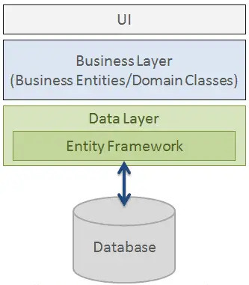
Structure:
As per the figure, Entity Framework fits between the business entities (domain classes) and the database. It saves data stored in the properties of business entities and also retrieves data from the database and converts it to business entities objects automatically.
Notes:
Next is structure of Entity framework.
As per the above figure, Entity Framework fits between the business entities (domain classes) and the database. It saves data stored in the properties of business entities and also retrieves data from the database and converts it to business entities objects automatically. Entity Framework serves as a bridge between the business entities, also known as domain classes or domain models, and the underlying database. It facilitates the storage and retrieval of data by mapping the properties of business entities to database tables and vice versa.
When saving data, Entity Framework automatically persists the state of business entities to the database. It maps each property of the business entity to a corresponding column in the database table, ensuring that the data is stored accurately and efficiently.
Similarly, when retrieving data, Entity Framework fetches records from the database and converts them into business entity objects. It populates the properties of these objects with the retrieved data, allowing developers to work with familiar object-oriented constructs in their code.

Slide 8

Entity Framework Features
Cross-platform
Modelling:
Querying
Change Tracking:
Saving:
Caching:
Built-in Conventionas:
Concurrency:
Configurations:
Migrations:
Transactions:
Entity FrameWork
Notes:
Next is Entity Framework Features they are
1st Cross-platform EF Core that means a cross-platform framework which can run on Windows, Linux and Mac.2nd Modelling means EF (Entity Framework) creates an EDM (Entity Data Model) based on POCO (Plain Old CLR Object) entities with get/set properties of different data types. It uses this model when querying or saving entity data to the underlying database.3rd Querying means EF allows us to use LINQ queries (C#/VB.NET) to retrieve data from the underlying database. The database provider will translate this LINQ queries to the database-specific query language (e.g. SQL for a relational database). EF also allows us to execute raw SQL queries directly to the database.4th Change Tracking means EF keeps track of changes occurred to instances of your entities (Property values) which need to be submitted to the database.5th Saving means EF executes INSERT, UPDATE, and DELETE commands to the database based on the changes occurred to your entities when you call the SaveChanges() method. EF also provides the asynchronous SaveChangesAsync() method.6th Concurrency means EF uses Optimistic Concurrency by default to protect overwriting changes made by another user since data was fetched from the database.7th Transactions means EF performs automatic transaction management while querying or saving data. It also provides options to customize transaction management.8th Caching means EF includes first level of caching out of the box. So, repeated querying will return data from the cache instead of hitting the database.9th Built-in Conventions meansEF follows conventions over the configuration programming pattern, and includes a set of default rules which automatically configure the EF model.10th Configurations means EF allows us to configure the EF model by using data annotation attributes or Fluent API to override default conventions. Migrations means EF provides a set of migration commands that can be executed on the NuGet Package Manager Console or the Command Line Interface to create or manage underlying database Schema.

Slide 9
Entity Framework Core
Entity Framework Core is the new version of Entity Framework after EF 6.x. It is open-source, lightweight, extensible and a cross-platform version of Entity Framework data access technology.
Entity Framework is an Object/Relational Mapping (O/RM) framework. It is an enhancement to ADO.NET that gives developers an automated mechanism for accessing & storing the data in the database.
EF Core is intended to be used with .NET Core applications. However, it can also be used with standard .NET 4.5+ framework based applications.
Notes:
Entity Framework Core
Now we are going to main topic Entity Framework Core.We are already talk about Entity framework Now What is Entity frame work Core? EF Core is the next generation of Entity Framework, designed to be lightweight, extensible, and cross-platform. It is open-source, allowing for community contributions and frequent updates. EF Core is optimized for modern application development scenarios and supports a wider range of platforms, including .NET Core, .NET Framework, and even Xamarin for mobile applications. Entity Framework is an Object/Relational Mapping (O/RM) framework. It is an enhancement to ADO.NET that gives developers an automated mechanism for accessing & storing the data in the database.Entity Framework Core is the new version of Entity Framework after EF 6.x. It is open-source, lightweight, extensible and a cross-platform version of Entity Framework data access technology. Entity Framework is an Object/Relational Mapping (O/RM) framework. EF Core is intended to be used with .NET Core applications. However, it can also be used with standard .NET 4.5+ framework based applications.

Slide 10
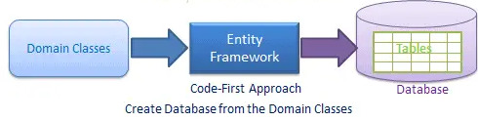
EF Core Development Approaches
EF Core supports two development approaches
1)Code-First:In the code-first approach, EF Core API creates the database and tables using migration based on the conventions and configuration provided in your domain classes. This approach is useful in Domain Driven Design (DDD).
Notes:
EF Core Development Approaches
Next is about EF Core Development Approaches
Entity Framework Core (EF Core) supports various development approaches to interact with databases, Code-First Approach,From this figure well understood that you start by defining your domain classes or entities. EF Core then generates the corresponding database schema based on these classes using Migrations.

Slide 11
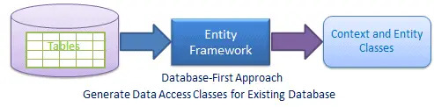
Database-First:In the database-first approach, EF Core API creates the domain and context classes based on your existing database using EF Core commands. This has limited support in EF Core as it does not support visual designer or wizard.
Notes:
Next is Database-First Approach.From this figure EF Core can reverse-engineer an existing database schema to create entity classes and a context that represent the database tables and relationships. In the database-first approach with Entity Framework Core (EF Core), you use commands like Scaffold-DbContext or dotnet ef dbcontext scaffold to generate domain classes (representing entities) and a data context based on an existing database schema. This method allows you to quickly create the necessary code to interact with your database.

Slide 12

Install Entity Framework Core
EF Core is not a part of .NET Core and standard .NET framework. It is available as a NuGet package. You need to install NuGet packages for the following two things to use EF Core in your application:
1.EF Core DB provider
2.EF Core tools
Notes:
Install Entity Framework Core
When go through implementation ,To install Entity Framework Core (EF Core) in your application, you'll need to follow these steps:
1st Install EF Core DB Provider, EF Core supports multiple database providers like SQL Server, MySQL, SQLite, PostgreSQL, etc. You need to install the NuGet package for the specific database provider you intend to use. For example, if you're using SQL Server, you would install the Microsoft.EntityFrameworkCore.SqlServer package. You can install it via the NuGet Package Manager Console or the NuGet Package Manager UI in Visual Studio, or using the dotnet add package command in the terminal.
2nd Install EF Core Tools: EF Core tools are required if you want to perform database migrations, scaffold a database, etc. You can install the EF Core tools globally or locally to your project. The package you need is Microsoft.EntityFrameworkCore.Tools. Again, you can install it via the NuGet Package Manager Console or the dotnet add package command.
Once you've installed these packages, you'll have access to EF Core in your application, and you can start using it to interact with your database, create migrations, and more. Remember to configure your DbContext class appropriately and set up your database connection string in your application configuration.

Slide 13
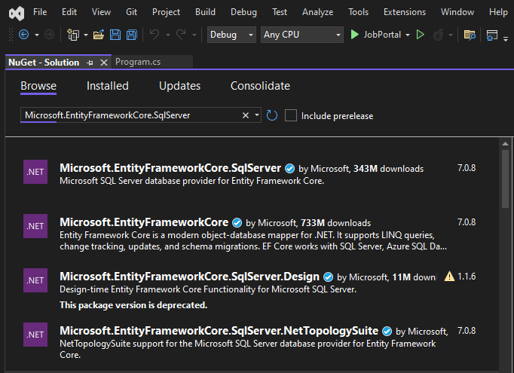
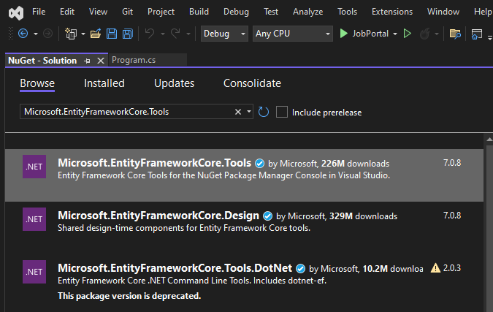
EF Core DB provider and Tool is installed by NuGet Package Manager UI in Visual Studio
Notes:
When you are installing through NuGet Package Manager UI in Visual Studio, it is like this.

Slide 14
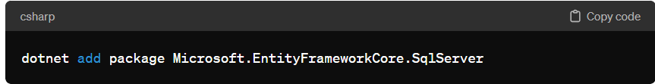
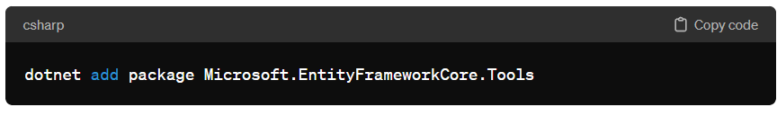
EF Core DB provider and Tool is installed using dotnet add package Command terminal
Notes:
When you are installing through dotnet add package Command terminal, it is like this.

Slide 15
Creating a Model for an Existing Database in Entity Framework Core
Reverse engineering command creates entity and context classes (by deriving DbContext) based on the schema of the existing database.
Scaffold-DbContext command. This reverse engineering command creates entity and context classes (by deriving DbContext) based on the schema of the existing database.The following parameters can be specified with Scaffold-DbContext in Package Manager Console:
Scaffold-DbContext [-Connection] [-Provider] [-OutputDir] [-Context] [-Schemas>][-Tables>][-DataAnnotations][-Force][-Project][-StartupProject] [<CommonParameters>]
Notes:
Creating a Model for an Existing Database in Entity Framework Core (Data-base first Approach)
. Here you will learn how to create the context and entity classes for an existing database in Entity Framework Core. Creating entity & context classes for an existing database is called Database-First approach.Here, we are going to create an Entity Data Model (EDM) for an existing database in database-first approach and understand the basic building blocks. Reverse engineering command creates entity and context classes (by deriving DbContext) based on the schema of the existing database
Scaffold-DbContext Command
This reverse engineering command creates entity and context classes (by deriving DbContext) based on the schema of the existing database.The following parameters can be specified with Scaffold-DbContext in Package Manager Console

Slide 16
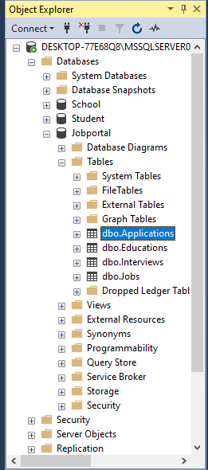
Excersise:
Create entity and context classes for the following Jobportal database
Notes:
Let’s we start with an example, That is creating Domain classes and entities for this database tables Applications,Educations,Interviews,Jobs.Lets we start with this example,Here there is four tables applications,Educations,interviewa,Jobs.We want to convert this database tables to domain objects…

Slide 17

PM>Scaffold-DbContext Server=.\SQLExpress; Database=JobPortal; Trusted_Connection=True;" Microsoft.EntityFrameworkCore.SqlServer -OutputDir Models
DB Server: Server=.\SQLExpress;
Database name :JobPoratal
Security info:Trusted_Connection=True;
SQLServer provider : Microsoft.EntityFrameworkCore.SqlServer.
-OutputDir :Directory where we want to generate all the classes which is the Model
Notes:
For this execute this command. In this command, the first parameter is a connection string which includes three parts,DB Server, database name and security info. Here, Server=.\SQLExpress; refers to local SQLEXPRESS database server. Database=JobPortal; specifies the database name "JobPortal" for which we are going to create classes. Trusted_Connection=True; specifies the Windows authentication. It will use Windows credentials to connect to the SQL Server. The second parameter is the provider name. We use provider for the SQL Server, so it is Microsoft.EntityFrameworkCore.SqlServer. The -OutputDir parameter specifies the directory where we want to generate all the classes which is the Models folder in this case. This command Scaffold-DbContext command creates entity classes for each table in the SchoolDB database and context class (by deriving DbContext) with Fluent API configurations for all the entities in the Models folder.

Slide 18
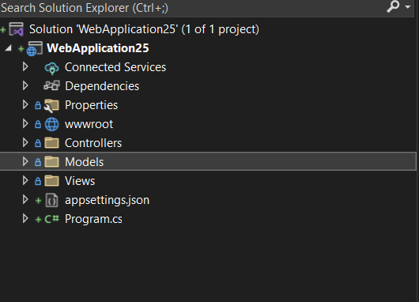
Example:
Scaffold-DbContext command creates entity classes for each table in the JobPortal database and context class (by deriving DbContext) with Fluent API configurations for all the entities in the Models folder.
Notes:
After the execution of Scaffold-DbContext Command The folder structure is like this. For each table in the specified database, Entity Framework Core generates a corresponding entity class. These classes are typically Plain Old CLR Objects (POCOs) that represent the structure of the database tables. Each property in the entity class corresponds to a column in the table. The generated classes include attributes and configurations to map the properties to the corresponding database columns.The DbContext class is also present in that folder also. The database context class, derived from DbContext, serves as the main entry point for interacting with the database. It contains DbSet properties for each entity class, allowing you to query and manipulate data in the associated database tables. The context class also manages the database connection and transactional behavior. The Scaffold-DbContext command generates this class and configures it to work with the entity classes generated from the database schema. Fluent API Configurations: In addition to generating entity classes and the context class, Scaffold-DbContext can also create Fluent API configurations for entity relationships, indexes, and other advanced mappings. Fluent API configurations provide a way to define more complex mappings that cannot be expressed using data annotations alone. These configurations are typically included in the OnModelCreating method of the context class and provide detailed instructions to Entity Framework Core on how to map entity properties to database tables and columns.

Slide 19
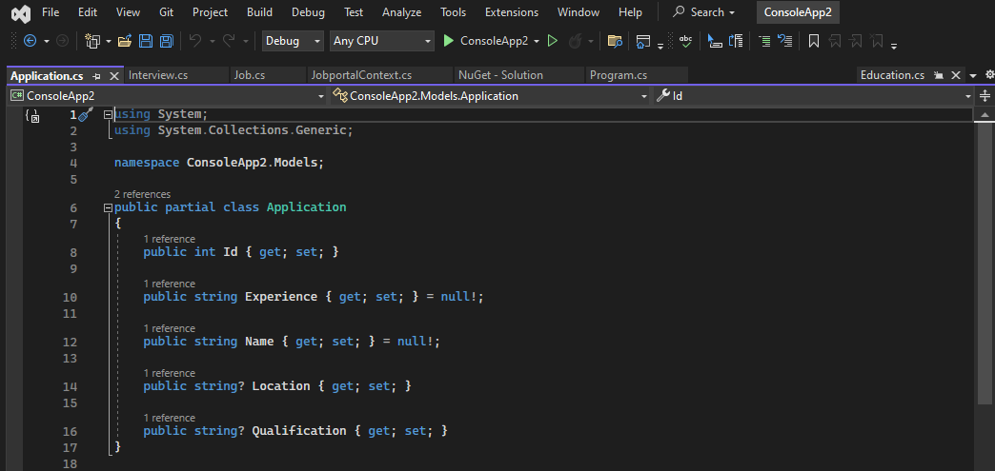
Example:
Notes:
When we expand domain class Each property in the entity class corresponds to a column in the table.For example when expand Application domain classs for all the columns of the application table in databse is represented as properties in domain classs..

Slide 20

Entity Framework Core: DbContext
The DbContext class is an integral part of Entity Framework.
An instance of DbContext represents a session with the database which can be used to query and save instances of your entities to a database. DbContext is a combination of the Unit Of Work and Repository patterns.
Notes:
Entity Framework Core: DbContext
Entity Framework Core's DbContext is a crucial component in the EF Core library. It represents a session with the database, allowing you to query and manipulate data in your database. DbContext acts as a bridge between your domain or entity classes and the database. The combination of the Unit of Work and Repository patterns in Entity Framework Core's DbContext provides a structured approach to managing data access and manipulation in an application. The Unit of Work pattern is a design pattern that helps to manage transactions and the overall process of committing changes to the database.In the context of Entity Framework Core, DbContext acts as a Unit of Work. It represents a single session with the database during which one or more database operations can be performed.DbContext tracks changes made to entities within its session and enables you to commit these changes as a single transaction when calling SaveChanges() method. This ensures that all changes are either committed together or rolled back if an error occurs. The Repository pattern is another design pattern that abstracts the logic required to access data from a data source.In the context of Entity Framework Core, repositories are typically implemented as classes that encapsulate data access logic for a specific entity or group of entities.DbContext serves as a repository in Entity Framework Core by providing access to the underlying database and methods for querying, inserting, updating, and deleting entities.While Entity Framework Core provides a generic repository pattern through DbSet<T> properties on DbContext, you can also create custom repositories to encapsulate more complex data access logic if needed. In summary, DbContext in Entity Framework Core combines the Unit of Work and Repository patterns by serving as a session with the database (Unit of Work) and providing methods for querying and saving entities (Repository). This approach promotes separation of concerns, abstraction of data access logic, and easier management of transactions and database operations within your application.

Slide 21

DbContext in EF Core allows us to perform following tasks:
Manage database connection
Configure model & relationship
Querying database
Saving data to the database
Configure change tracking
Caching
Transaction management
This context class typically includes DbSet<TEntity> properties for each entity in the model.
Notes:
DbContext in EF helps to perform Manage database connection: DbContext manages the underlying database connection automatically. It opens connections when needed and closes them when they're no longer required. You can also configure connection strings and other connection-related settings in the DbContext., Configure model & relationship, Querying database, Saving data to the database, Configure change tracking, Caching, Transaction management
Configure model & relationship: DbContext allows you to configure the model and define entity relationships using fluent API or data annotations. You can specify entity properties, primary keys, indexes, foreign keys, and other aspects of the database schema.
Querying database: DbContext provides methods for querying the database using LINQ (Language Integrated Query) expressions. You can query entities directly or use methods like Find, SingleOrDefault, FirstOrDefault, Where, etc., to retrieve data from the database.
Saving data to the database: DbContext tracks changes made to entities within its session and provides a SaveChanges method to persist these changes to the database. It automatically generates the necessary SQL statements to insert, update, or delete records based on the changes detected in the tracked entities.
Configure change tracking: DbContext includes change tracking mechanisms that monitor modifications made to entities. It tracks changes to entity properties and maintains their current and original values, allowing you to detect what has changed and apply those changes when saving data to the database.
Caching: DbContext includes an internal caching mechanism that helps improve performance by storing entities that have been queried or manipulated within its session. This caching can reduce the need to retrieve the same data from the database repeatedly during a single session.
Transaction management: DbContext allows you to manage transactions when performing multiple database operations as a single unit of work. You can use Transaction APIs to begin, commit, or rollback transactions, ensuring that changes are either committed together or rolled back if an error occurs.
Overall, DbContext in Entity Framework Core provides a comprehensive set of features for interacting with the database, configuring data models, tracking changes, and managing transactions, making it a powerful tool for data access and management in .NET core applications.
To use DbContext in our application, we need to create a class that derives from DbContext.In the Context class turn domain classes into entities by specifying them as DbSet<TEntity> type properties. This will allow Entity Framework to track their changes and perform CRUD operations accordingly.

Slide 22
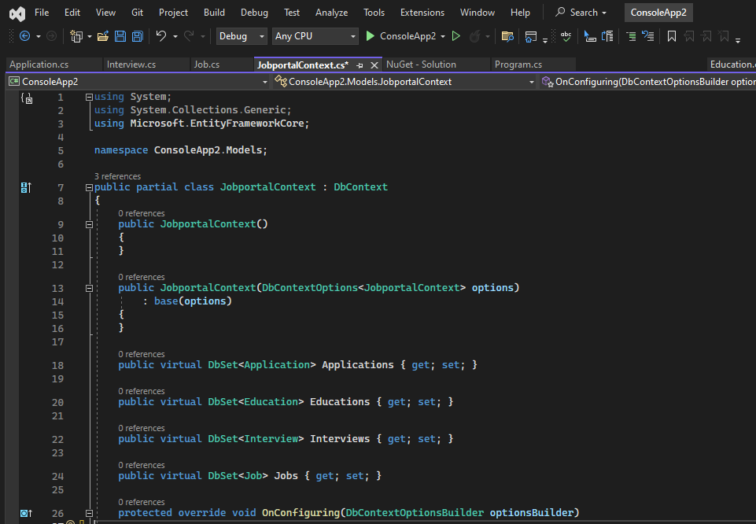
Example:
The following is the JobportalContext class which you can use to save or retrieve data.
In the example above, the JobportalContext class is derived from the DbContext class and contains the DbSet<TEntity> properties of Applications, Educations ,Interviews and Jobs type.
Notes:
Let’s come through the example when we run the reverse scaffold command we already said that DbContext class is also created. The JobportalContext class is a typical example of a database context class in Entity Framework Core. It derives from the DbContext class and contains DbSet<TEntity> properties for each entity type in your application. These DbSet<TEntity> properties represent collections of entities that correspond to database tables.Here entites are Applications,Education,Interviews,Jobs.With the JobportalContext class defined, you can now use it to perform data access operations such as querying, inserting, updating, and deleting entities in your database. You can obtain an instance of the JobportalContext class through dependency injection in your application's services or controllers, and then use it to interact with the database using Entity Framework Core's ORM capabilities.

Slide 23
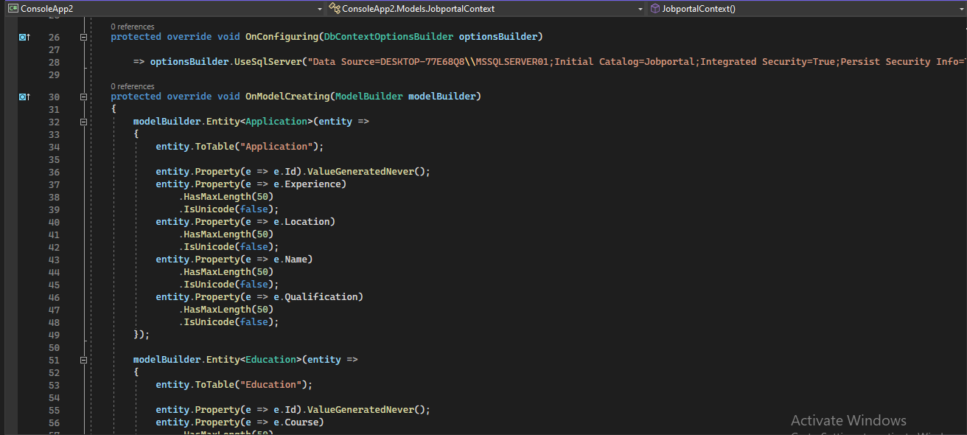
OnConfiguring():method allows us to select and configure the data source to be used with a context using DbContextOptionsBuilder.
OnModelCreating():method allows us to configure the model using ModelBuilder Fluent API.
Notes:
Here also a OnConfiguring(), OnModelCreating(). The OnConfiguring and OnModelCreating methods are crucial parts of the DbContext class in Entity Framework Core. Let's dive into each one
OnConfiguring() method is called by EF Core when the context is being configured. It is typically used to configure the database provider and connection string. You can override this method in your JobportalContext class to specify the database provider and connection string directly in code. OnModelCreating(ModelBuilder modelBuilder). This method is called by EF Core when the model for the context is being created. It allows you to configure the model using the Fluent API provided by ModelBuilder. You can use this method to specify entity mappings, relationships, indexes, and other aspects of the model.

Slide 24
Code First Approach
Domain of your application and start creating classes for your domain entity rather than design your database first and then create the classes which match your database design.
Create/Modify Domain Classes
Automated/Code Based Migration
Configure Domain Classes
Database
Notes:
Code First Approach
Next approach is Code First Approach, Code-First is mainly useful in Domain Driven Design. In the Code-First approach, you focus on the domain of your application and start creating classes for your domain entity rather than design your database first and then create the classes which match your database design. EF API will create the database based on your domain classes and configuration. This means you need to start coding first in C# or VB.NET and then EF will create the database from your code.This figure illustrate the code-first development workflow. The development workflow in the code-first approach would be Create or modify domain classes then configure these domain classes using Fluent-API or data annotation attributes then Create or update the database schema using automated migration or code-based migration.

Slide 25
Creating the Model
Entity Framework needs to have a model (Entity Data Model) to communicate with the underlying database. It builds a model based on the shape of your domain classes, the Data Annotations and Fluent API configurations.
The EF model includes three parts:
1.Conceptual model:Builds based on your domain classes (entity classes), the context class and configurations
2. storage model:Builds based on the Provider we use.
3. Mapping between the conceptual and storage models.
Notes:
Entity Framework relies on a model, known as the Entity Data Model, to facilitate communication with the underlying database. This model is constructed based on various elements within your application's structure. Entity Framework constructs its model based on various elements, Domain Classes, Data Annotations, Fluent API Configurations, Entity Framework uses the information from these sources to build a comprehensive model that maps the domain classes to the underlying database schema. This model serves as the foundation for communication between the application and the database, allowing EF to perform tasks such as querying, inserting, updating, and deleting data with ease. By leveraging the shape of the domain classes and the configurations provided through Data Annotations and Fluent API, Entity Framework streamlines the development process and provides a seamless abstraction over the database layer.Model is based on several components. That is Conceptual Model: This part of the EF model is constructed from the domain classes (also known as entity classes or POCOs), the DbContext (context class), and any configurations applied using Data Annotations or Fluent API. It represents the conceptual view of the application's domain. Storage Model: The storage model represents the underlying database schema, including tables, columns, constraints, etc. This model is influenced by the database provider being used (e.g., SQL Server, MySQL) and the specific database itself. Mapping: The mapping between the conceptual and storage models establishes how the entities and their properties are persisted in the database. Entity Framework automatically generates this mapping based on conventions and configurations defined in the entity classes and the DbContext.

Slide 26
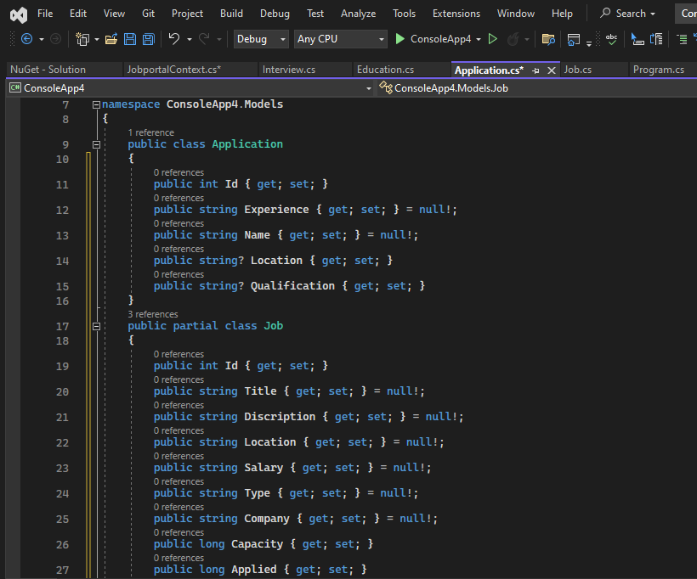
Here the Classes for the Application and Job

Slide 27
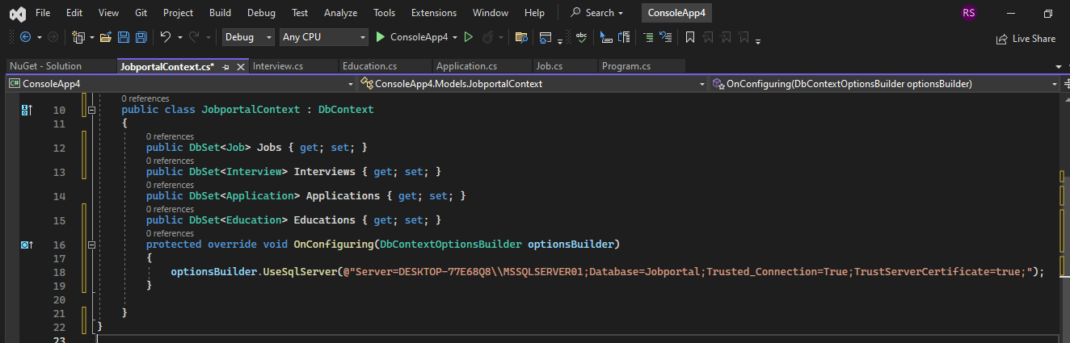
SchooJobportalContext class :
Above context class includes four DbSet<TEntity> properties, for Jobs,Applications,Interviews and Education type which will be mapped to the Jobs,Applications,Interviews and Educations tables in the underlying database.
OnConfiguring() method, an instance of DbContextOptionsBuilder is used to specify which database to use.
Notes:
In the Code first approach first we have to create a context class. The context class in Entity Framework serves as the bridge between the application and the database, managing the entity classes and facilitating data access operations. In this scenario, the context class includes four DbSet<TEntity> properties, Jobs: Represents the entity set for jobs data.Applications: Represents the entity set for job applications.Interviews: Represents the entity set for interview records.Educations: Represents the entity set for educational qualifications. Each DbSet<TEntity> property corresponds to a specific entity type and will be mapped to a corresponding table in the underlying database. The OnConfiguring() method within the context class is used to configure the database connection. Inside this method, an instance of DbContextOptionsBuilder is used to specify which database provider to use, along with the connection string or other necessary configurations.

Slide 28

Adding a Migration
EF Core includes different migration commands to create or update the database based on the model.
We can execute the migration command using NuGet Package Manger Console
Notes:
Adding a Migration
Entity Framework Core provides a set of migration commands that enable developers to create or update the database schema based on changes made to the model.
These migration commands are typically executed using the NuGet Package Manager Console within Visual Studio, although they can also be run via the command line interface (CLI) using the dotnet ef command. Some of the common migration commands include:Add-Migration-Creates a new migration based on changes detected in the model since the last migration. Update-Database-Applies pending migrations to the database, creating or updating the schema as necessary. Remove-Migration: Removes the last migration. Script-Migration: Generates a SQL script for a migration without applying it to the database. To execute these migration commands using the NuGet Package Manager Console:Open Visual Studio. Navigate to Tools > NuGet Package Manager > Package Manager Console. Enter the desired migration command (e.g., Add-Migration, Update-Database) along with any necessary parameters. Press Enter to execute the command.

Slide 29
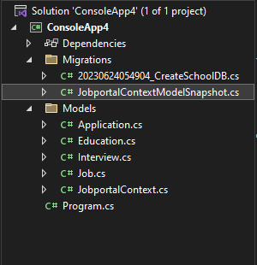
To Add Migration:
PM> Add-Migration CreateJobportal
Notes:
Here the Command to Add Migration with name CreateJobPortal,Afterb executing the command a class is added to the migration folder with name of the migration

Slide 30
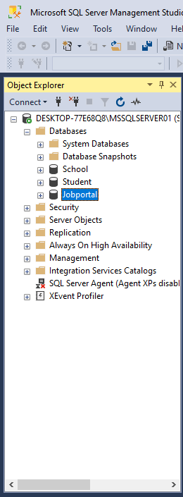
After creating a migration, we still need to create the database using the update-database
PM>update-database -Jobportal
Notes:
After creating a migration using the Add-Migration command in Entity Framework Core, the changes represented by that migration are not automatically applied to the database. Instead, we need to explicitly apply the migration to the database using the Update-Database command. The Update-Database command takes the pending migrations and applies them to the target database, creating or updating the schema as necessary to reflect the changes made to the model. It's essential to execute the Update-Database command after creating a migration to ensure that the database schema remains synchronized with the application's model. This process allows for controlled and incremental changes to the database schema, ensuring that migrations are applied in a predictable and consistent manner. To execute the Update-Database command, open the NuGet Package Manager Console in Visual Studio and enter Update-Database, optionally specifying a migration name or other parameters as needed. Once the Update-Database command completes successfully, the changes represented by the migration will be applied to the target database, and it will be in sync with the application's model.

Slide 31

Notes:
We discuss about EF and all aspects of EF.. Entity Framework (EF) is a powerful Object-Relational Mapping (ORM) framework for .NET developers, providing a seamless way to interact with databases using object-oriented programming paradigms. With EF, developers can work with domain classes that represent entities in the application's domain, abstracting away the complexities of database interaction. EF supports multiple workflows, including Code First, Database First, and Model First approaches, allowing developers to choose the workflow that best fits their project requirements and preferences. EF also provides advanced features such as migrations, which enable developers to manage changes to the database schema over time through code-first development. Overall, Entity Framework streamlines database interactions in .NET applications, enabling developers to focus more on application logic and less on database-related concerns. Its versatility and ease of use make it a preferred choice for many .NET developers when building data-driven applications.thank you

